Slide 1
Data science project at exposys data labs
Contributor: kanthala sai srujan reddy

Slide 2
Contents:
Introduction: 3-4
Problem statement: 5
Existing system: 6
Proposed system: 7
System architecture: 8-9
Hardware requirements: 10-11
Software requirements: 12
Development:3-15
Screenshots/results: 16-19
Conclusion: 20

Slide 3
Introduction:
This is a data science project to predict diabetes disease using a machine learning model
It helps the user to find out if there is a chance of them being affected by diabetes
There are various medical facilities to check if one has diabetes but they don’t predict if one has diabetes

Slide 4
Continued:
Predicting diabetes is helpful for the user to understand their medical status and take measures accordingly.
It’s also functions as a simple diagnosis tool before visiting a doctor, medical visits are deemed to be expensive
This machine learning model is very affordable and effective

Slide 5
Problem Statement:
To predict if a patient has diabetes using a machine learning model
Building an affordable solution for diabetes diagnosis before visiting a doctor
The machine learning model has to be highly accurate

Slide 6
Existing System:
Healthcare centres for diagnosis
Multi speciality hospitals
Super expensive doctors

Slide 7
Proposed system:
To develop a machine learning model that predicts diabetes
The machine learning model is supposed to alarm the user if he has a probability of getting diabetes and suggest him to change his lifestyle

Slide 8
System Architecture:
PIMA data set
Data pre processing
Training set
Test set
ML model
Predicted outcome

Slide 9
Hardware requirements:
CPU:
Minimum: intel core i3 equivalent
Recommended: intel core i5 or amd ryzen 5 equivalent
RAM:
Minimum: 4GB RAM
Recommended: 8GB RAM

Slide 10
continued:
Disk space:
Recommended: 50 GB available disk space

Slide 11
Software requirements:
Operating system:
windows/macOS/Ubuntu
Other requirements:
Anaconda jupyter notebook
Data set from kaggle to train machine learning model
Visual studio to view the data visualisation

Slide 12
Development:
Anaconda jupyter is used to build the machine learning model.
PIMA diabetes data set is used to train the machine learning model which is available at kaggle.com.
The data is pre processed to remove missing and duplicate values.
The data set is divided into two sets, one for training and the other for testing the machine learning model.

Slide 13
continued
The data set is divided into two sets, one for training and the other for testing the machine learning model.
80 percent of the data set is used to train the model and the remaining is used to test the machine learning model.
The data is split using train_test_split().
Random forest classifier is the machine learning algorithm used to train the machine learning model.

Slide 14
Continued:
It can be found in the scikit learn package
After the model is trained, it’s predictions with test set are compared against the actual results to measure the accuracy.
Now the visualisation can be done, other metrics like correlation can be used to find out the functional dependency but it is not done here.
The visualisation is done in the form of a graphic tree.

Slide 15
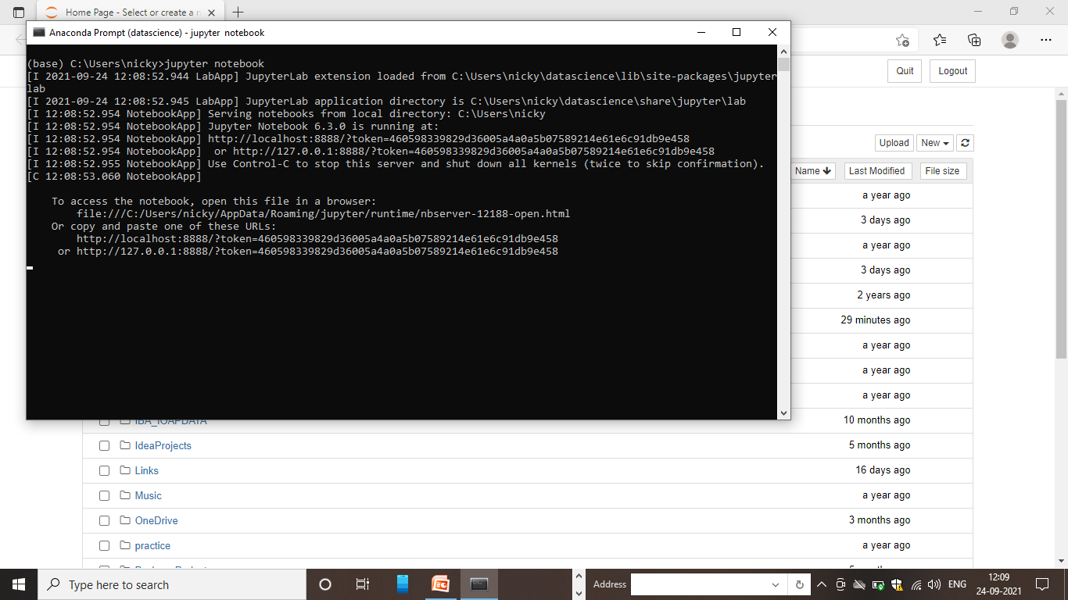
Screenshots/results:

Slide 16
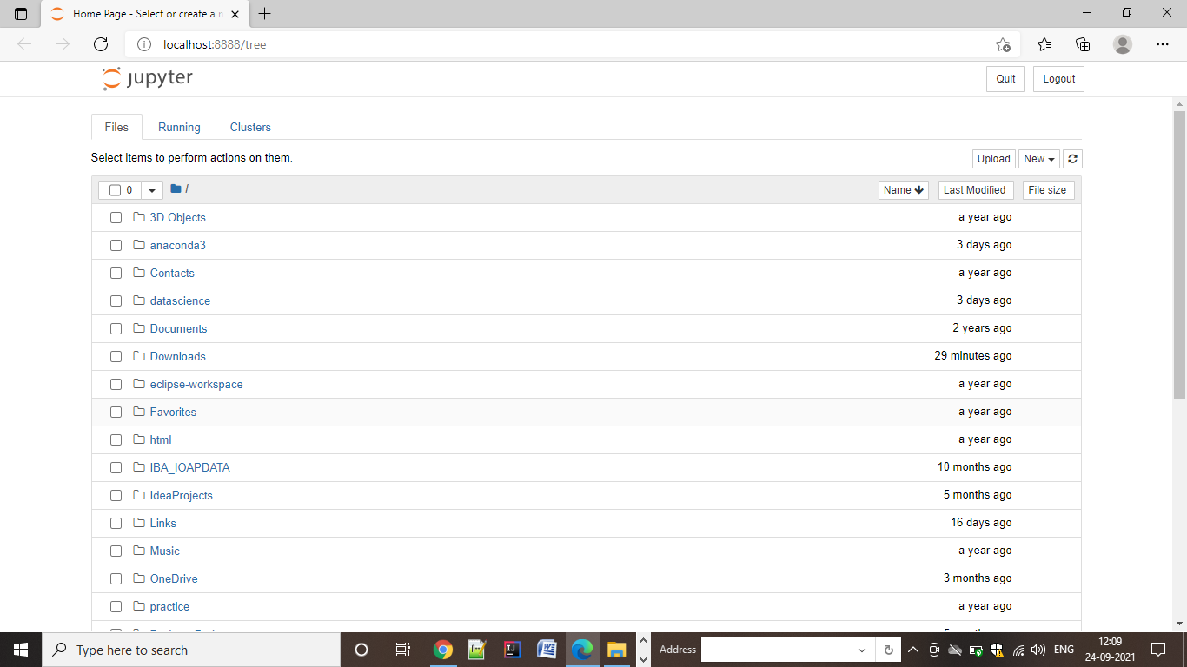

Slide 17
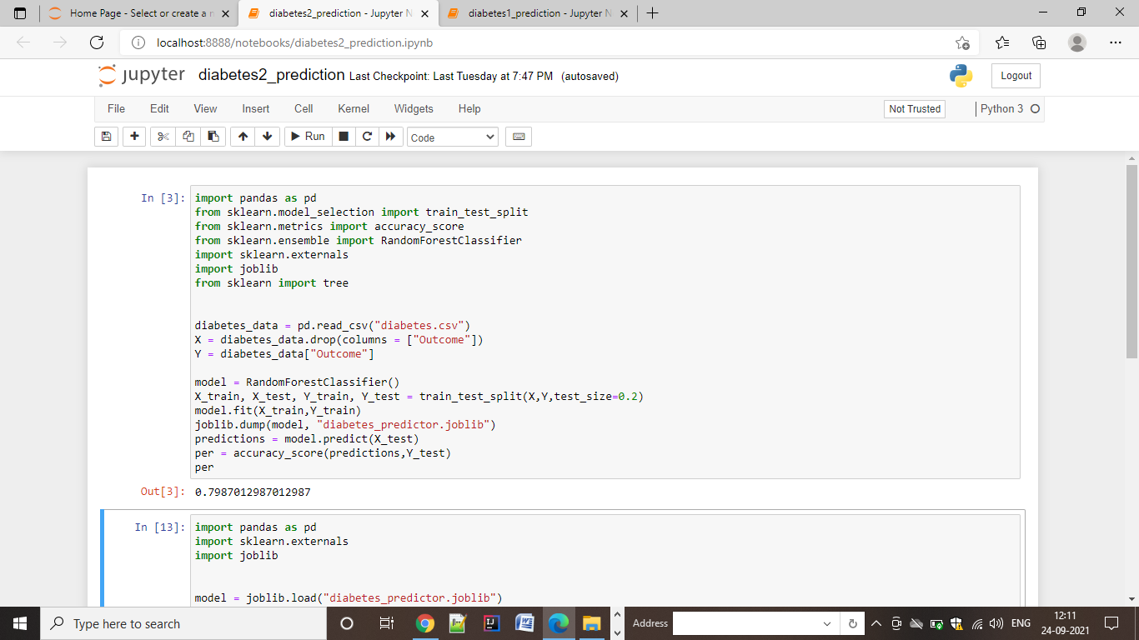

Slide 18
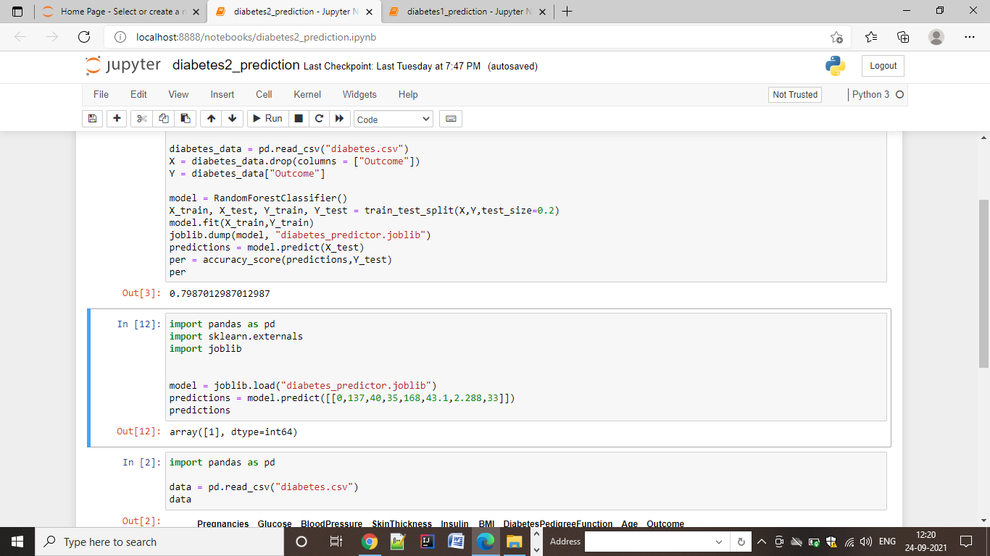

Slide 19
Conclusion:
This machine learning model alerts the user if he might have diabetes.
This helps the user to be alarmed and change his life style or visit a doctor.
This solution is a portable and affordable diabetes identifier.

Slide 20
Thank
you

